Slide 1
Dynamic Workflow Solutions
Dave Glover
Chief Executive Officer
Miles Cowan
Chief Technical Officer

Slide 2
Dave “Glove” Glover - Chief Executive Officer
Former NBA Executive; NJ Nets
Executive of Avid Sports; Sold to Pinnacle Systems in 2000
VP/GM of Pinnacle International Broadcast News and Sports
Patent Signal Capture and Distribution System; US6378132B1
CEO of Representing Emerging Products LLC; Consulting Firm
SVP Sales and Marketing MediaSolv
Acquired by Axon; served as Senior Director
Extensive Solutions Sales Experience with Partners, International Channels and Integrators

Slide 3
Miles Cowan – Chief Technical Officer
Co-founder of Insight Video Net in 2000
First Digital In-Car solution for LEAs
First Wi-Fi offload and cellular live streaming
Created Panasonic’s Arbitrator In-Car solution
Integrated Software (CMS) with Genetec for VMS DEMS
Created the first Network Interview Recording Solution
Sold the company to Axon (formally Taser International)
Extensive Digital Media Management experience and consultative design

Slide 4
The DWS Solution Set
Consulting and design services for data migrations, archiving, workflow processes, and legacy systems integration.
Data management tools for repeatable processes; tools that DWS provides under consulting agreements but leave behind for the customers to manage and use.
Full service custom engineering when the solution has no currently acceptable workflow.
Product development for OEM, or packaged as integrated solutions, for industry leading partners for resale; in particular, bundled solutions with the partner’s products in a VAR relationship.

Slide 5
Middleware
Essentially functioning as hidden translation layer, middleware enables communication and data management for distributed applications
Integration of video, meta-data and audits from an interview room application to a 3rd party DEMS.
Physical Evidence Management System integration with a Digital Evidence Management System.
Data migration (files, audits, meta-data) from old disparate applications into a new Enterprise solution.
Centralized search, playback and data entry for several disparate software applications.
In-car and Body Worn Camera integration with a 3rd party DEMS.

Slide 6
Interview Specifications
TAMPER-PROOF TECHNOLOGY
SHA-2 hashing algorithm and chain of custody including standard reports
VIDEO ENCODING
H.264 baseline and main profile (MPEG-4 part 10/AVC), streaming compliant (standard mp4)
CAMERA SECURITY
HTTPS encrypted communication to the camera, IEEE 802.1x network access control
SUPPORTED PROTOCOLS
  IPv4/v6, FTP, CIFS/SMB, SMTP, Bonjour, UPnP
POE SUPPORT
  Power over ethernet IEEE 802.3af / 802.3at type 1
COVERT OR OVERT CAMERAS
  Support for either style of camera
RUGGED
  Vandal resistant
BUILT IN REDUNDANCY
Redundant recording servers, RAID 1 redundancy for OS and application
ONVIF COMPLIANT
  Support for ONVIF compliant cameras
CLOUD BASED MANAGEMENT
Authentication, Configuration settings, Metadata and Audit Trails are all managed in the cloud

Slide 7




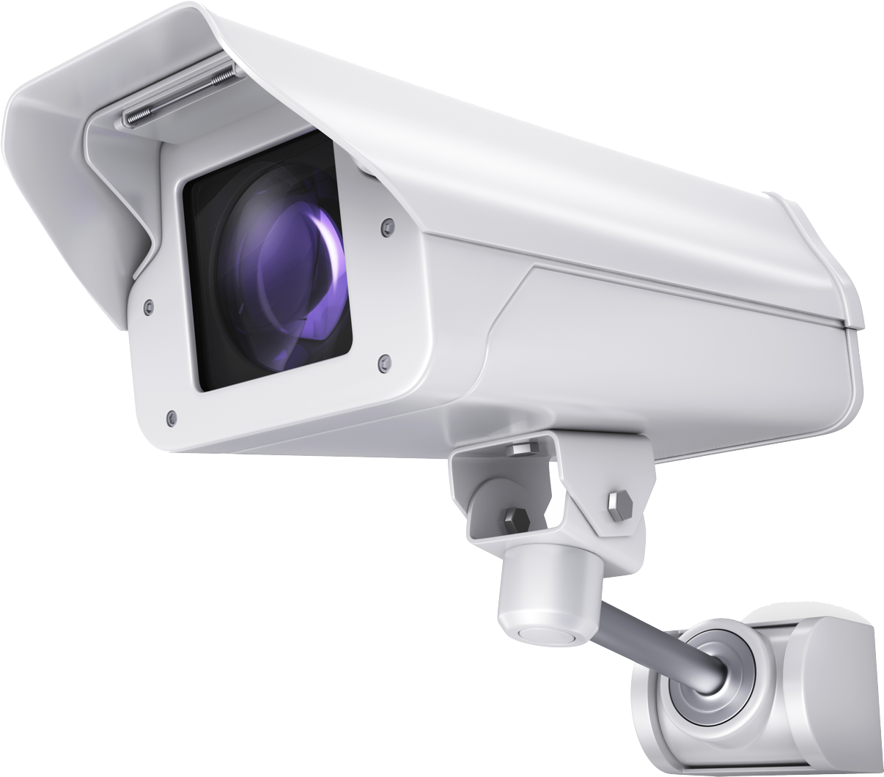
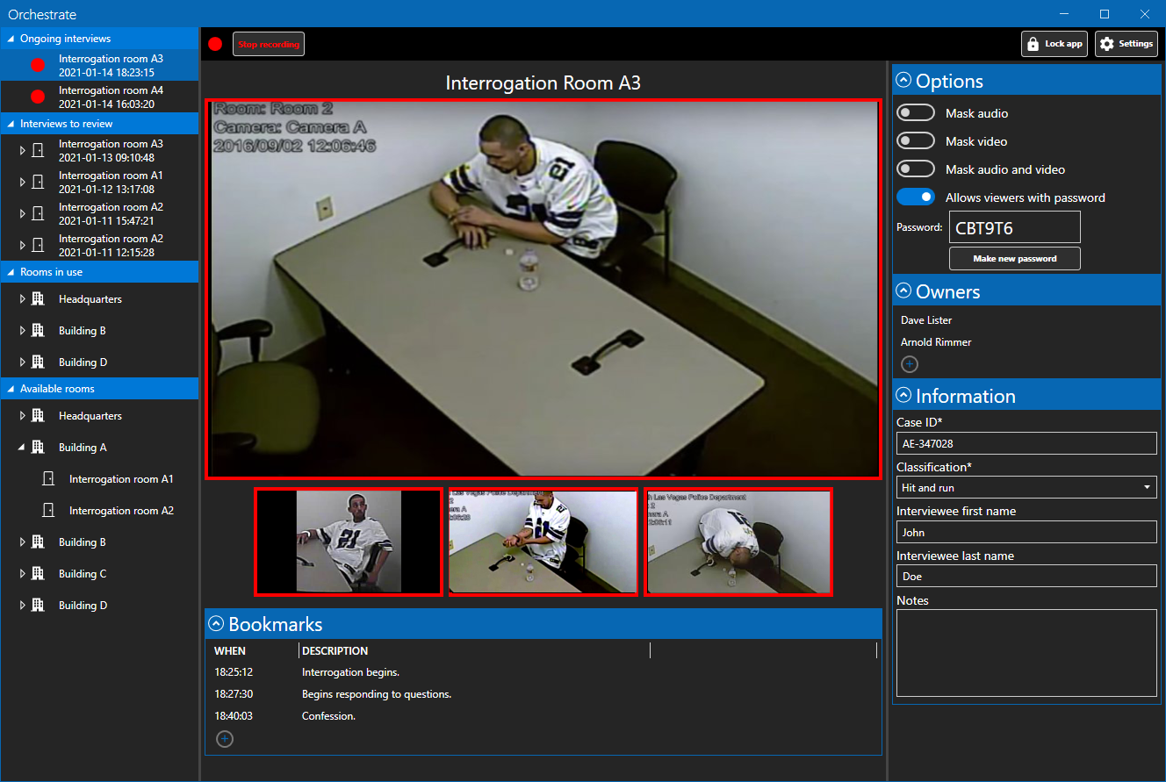





Event Recording Architecture
IP Cameras
Interview SW
Redundant recording architecture
3rd PARTY BACKEND INTEGRATIONS
Any Windows 10 IOT device or higher
Records Management System
Patient Management System
Digital Incident Management System
Case Management System
Digital Evidence Management System
Learning Management System

Slide 8
Interview
DYNAMIC BLOCKS
  Each block of information is dynamically informing the user of their event recording environment
MULTI CAMERA VIEWING
  The owner/user can view all cameras live and select one for expanded viewing
BOOKMARKS
  Users can enter in metadata bookmarks at anytime

Slide 9
Interview
MASKING VIDEO/AUDIO
  Cameras can be visually masked for privacy and audio can be muted without stopping the recording
MULTIPLE OWNERS
  Multiple owners can be assigned to an interview for security and stewardship
METADATA FORMS
  Customizable metadata forms with with options for required fields and dropdown lists

Slide 10
Interview
LIVE STREAMING
  Remote live streaming with dynamic security for each interview. The owner can choose to allow live streams or not and provide a temporary password to those that need to have access only during that interview.

Slide 11
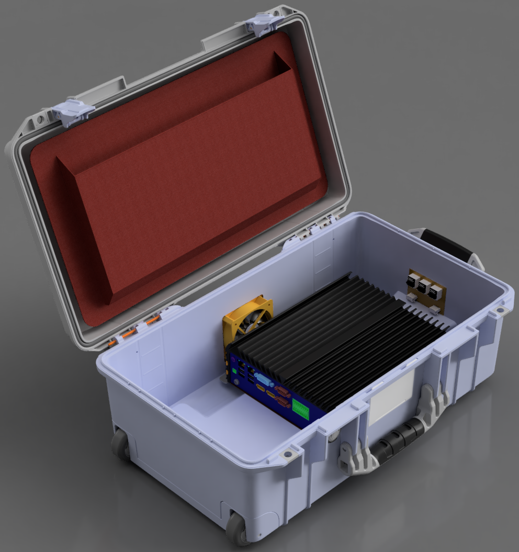
Event Recorder Ruggedized Portable
RUGGED NVR
  Industrial Computer With 9th Gen Intel, 4 POE+ ports and multiple SSD support, Wide Operating Temperature -25°C to 70°C, continuously, reliably through its fanless design
SECURE PORTS
3 Ethernet ports (POE+) and 2 USB ports
FAN
  High MTBF fan pulling the heat away from the NVR
PELICAN CASE
  Super-light proprietary HPX²™ Polymer, maximum airline carry on size and quiet Rolling Stainless-Steel Bearing Wheels

Slide 12
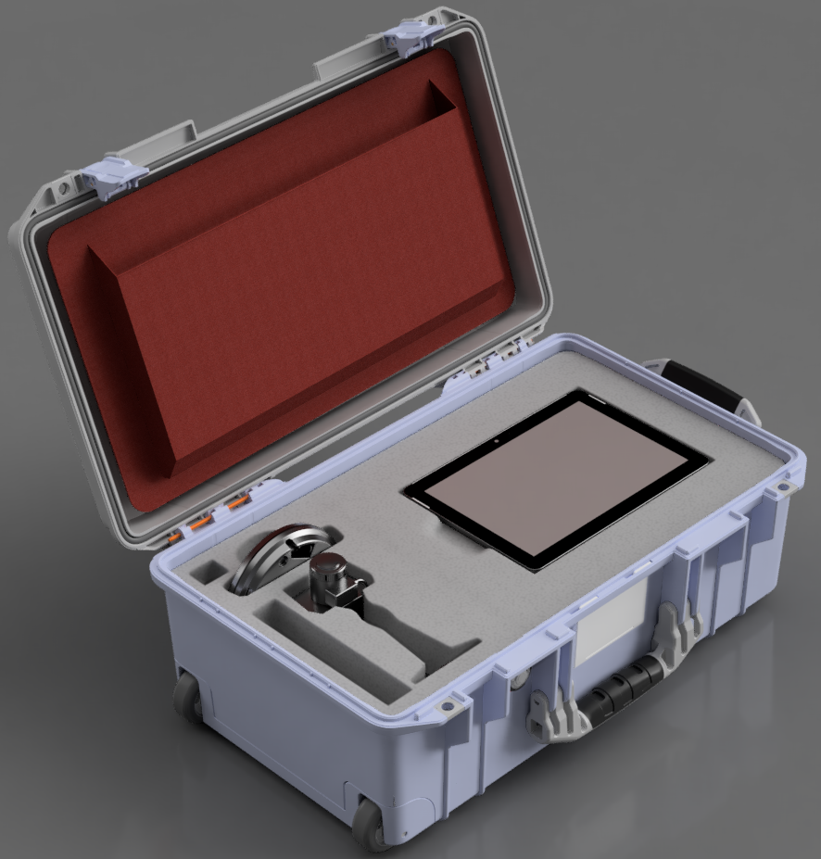
Event Recorder Ruggedized Portable
UTILITY POUCH
Can be used for miscellaneous cables, radios and more
10.4” TABLET
Laser cut foam to fit most consumer grade or rugged tablets running Windows 10
AXIS M5065 PTZ CAMERA
  Network Camera is a discreet, palm-sized PTZ camera that fits in anywhere with a built-in microphone
AXIS M1135 CAMERA
  Compact network camera that delivers superb image quality in 2 MP resolution with a built-in microphone

Slide 13
Data-Central Key Features
Provides data and media services to existing backend Evidence Management Solutions customers already own (DEMS / CMS)
Automated evidence/metadata extraction and package creation
Migrate from old software systems and eliminate risky silos of old technology away from aging/obsolete secondary devices
Automated evidence packaging from third-party systems
Support for 100’s of proprietary video file formats
Support for direct client workflows for VMS, RMS and CAD systems

Slide 14
The Data-Central Business Model
Data-Central Software is “SAS” or service-based model
It is an Enterprise License that can be installed anywhere Digital Evidence is captured, managed, disclosed, or distributed
Customers pay per GB consumed in managing and converting Digital Media Evidence
Like a data phone plan, customers purchase blocks of data and are tracked and notified on the status of their account balance
OPEX procurement instead of CAPEX purchases for convenience

Slide 15


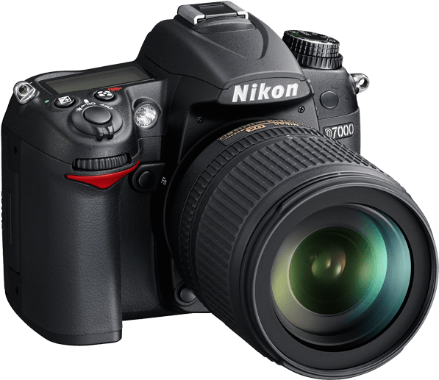
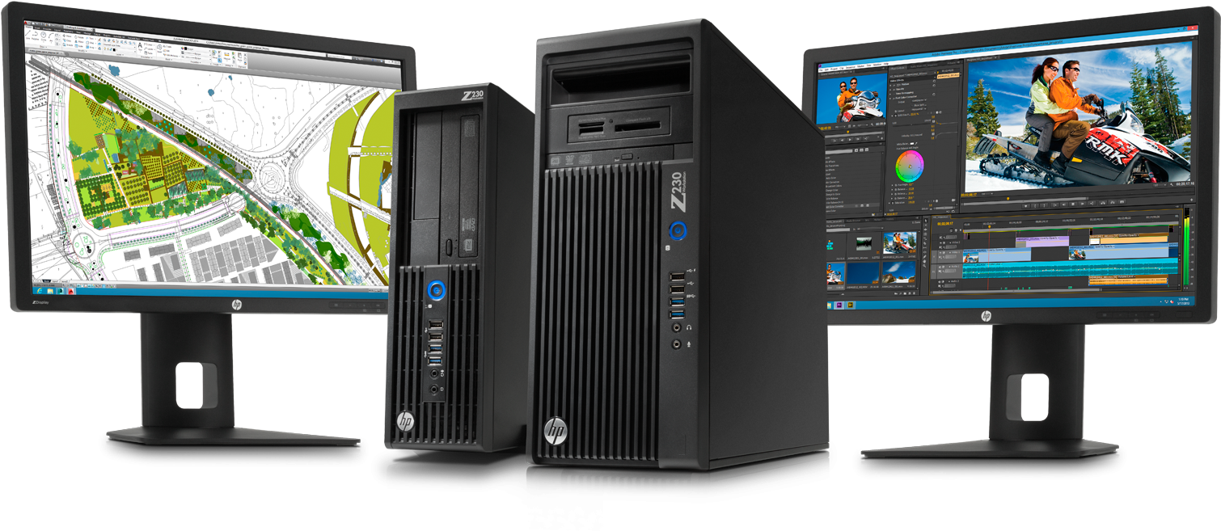
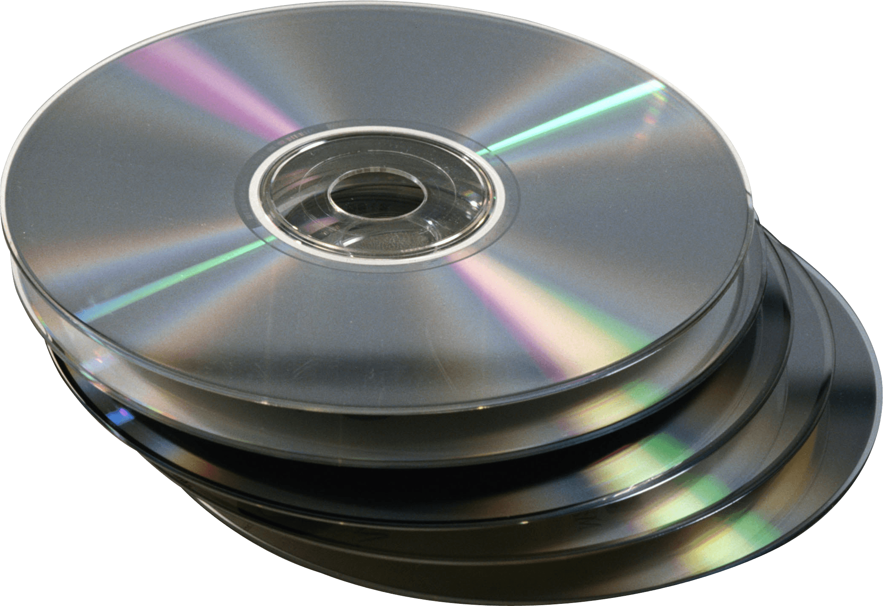
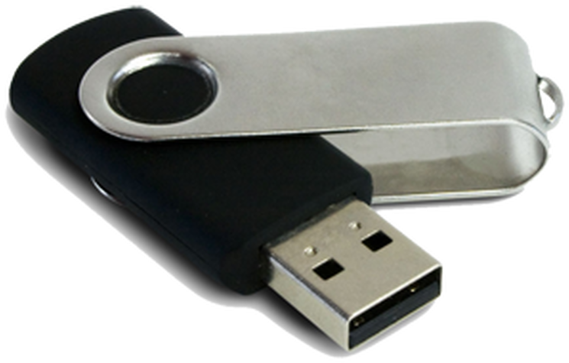
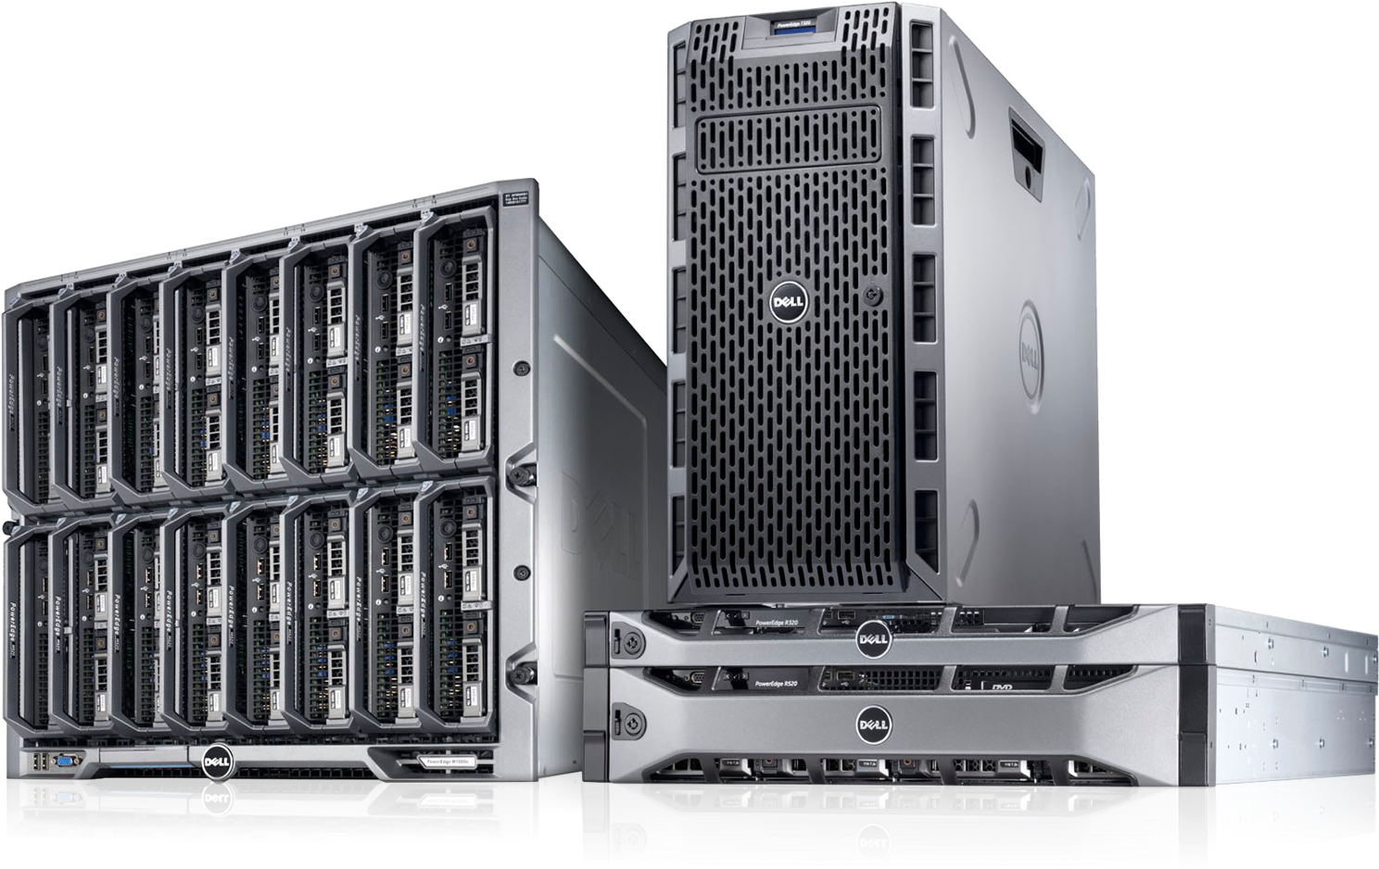
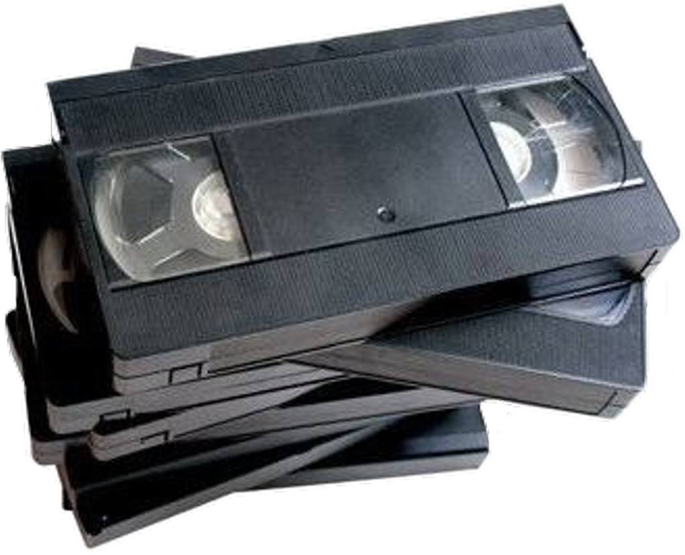




Data-Central Architecture
Video
Management
System
Photo
Management
System
DEMS
Cloud
Services
Thumb
Drives
Client UI
CD/DVD
On-prem
Services
HOT
WARM
COLD
VHS Tape
LTO Tape

Slide 16
Data-Central Architecture
As expressed in the image, secondary devices are ingested into Data-
Central as a single migration process. Third party software, Video Management
Systems, Photo Management Systems, and more, may also be ingested
ongoingly as an integration. Data-Central ingests all digital files, standard and proprietary, as well as entire folder structures while its form is maintained. The files will have metadata added to them, both manually and automatically; EXIF data may be pulled from each file for additional key metadata.

Slide 17
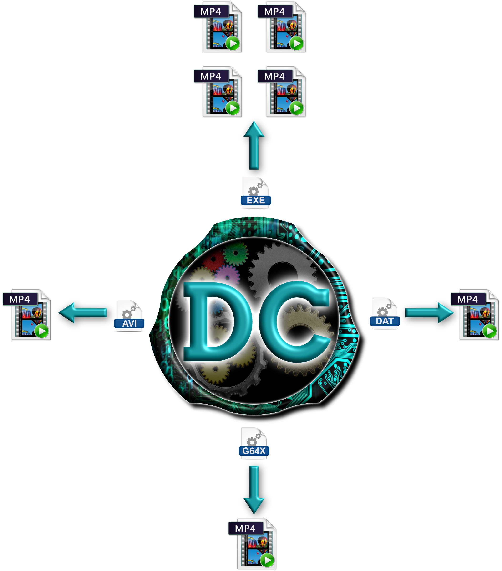
Data-Central Architecture
One workflow option for Data-Central is to rewrap proprietary video into
standard MP4 files as expressed in the image below. The process is NOT
transcoding and takes a third of the processing time required by the usual
procedure. Once the files have been rewrapped, any standard media player will be able to play them. Data-Central is able to handle executable (EXE) files or
any other video files containing multiplexed video (i.e., 2 x 2, 3 x 3, 4 x 4) and will rewrap the video into individual MP4 files. For example, if an EXE file was sent to Data-Central and it contained a 4 x 4 multiplexed video with a proprietary player, the result would be 16 individual MP4 files.

Slide 18
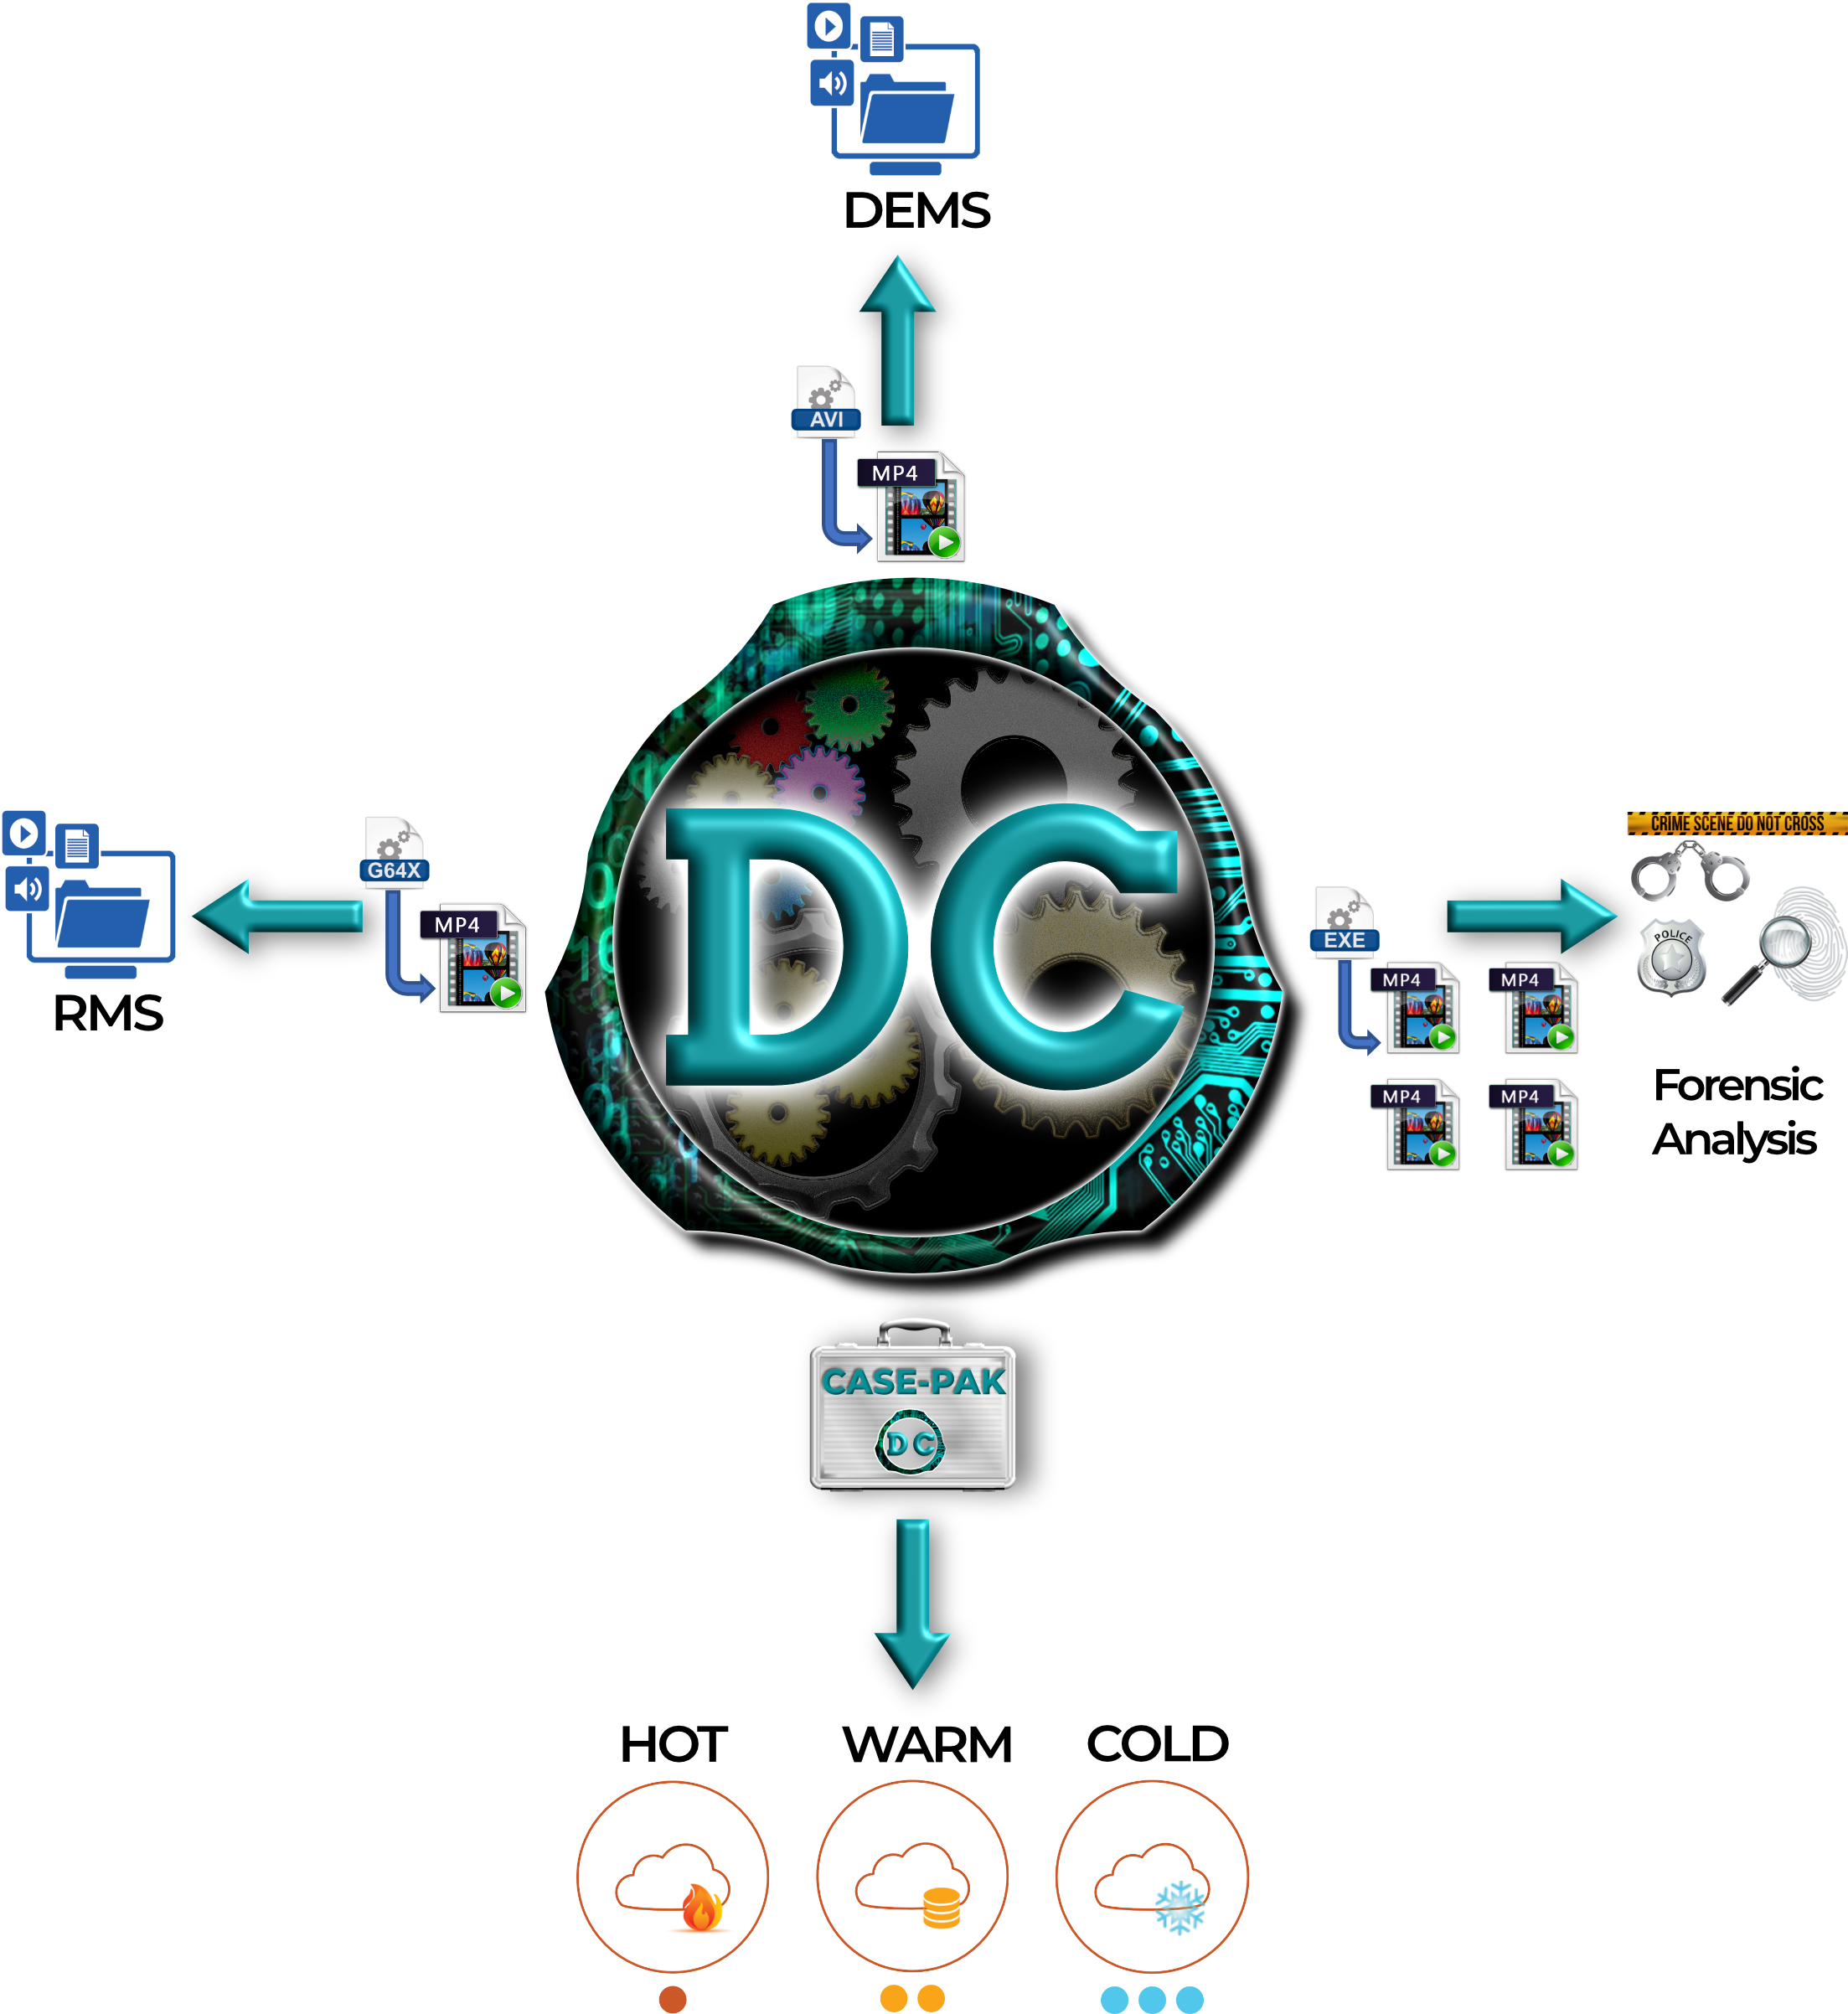
Data-Central Architecture
As expressed in the image, Data-Central will dynamically run files through different preferred workflows. One workflow option for Data-Central is
to send the files to other third-party systems, such as a Digital Evidence
Management System, Records Management System, and others. Some files may need to be sent to a forensic enhancement tool to be deblurred, lightened up, redacted, or edited as desired. Lastly, the files could be sent to hot, warm, or cold storage (cloud or on-premises) for long term storage. Data-Central will also create a parent-child relationship between the original file and the newly created MP4, to be treated and moved as one unit.

Slide 19

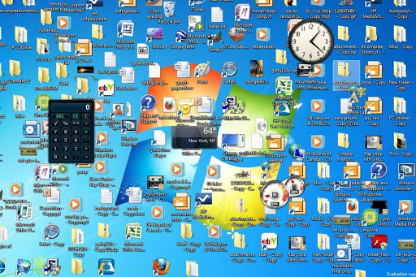
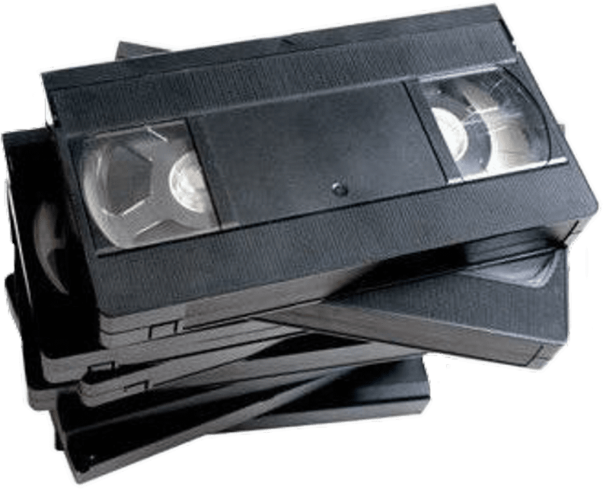

Secondary Device Archiving
3rd PARTY BACKEND INTEGRATIONS
User Metadata entry
Records Management System
Patient Management System
Digital Incident Management System
Case Management System
Digital Evidence Management System
Learning Management System
Digital Triage interface for Data-Central

Slide 20











Migration / Archiving Workflow
Thumb
Drives
CD/DVD
VHS
LTO
External
HDD
3rd Party
DB
3rd PARTY BACKEND INTEGRATIONS
Records Management System
Patient Management System
Digital Incident Management System
Case Management System
Digital Evidence Management System
Learning Management System
Servers /
Storage

Slide 21
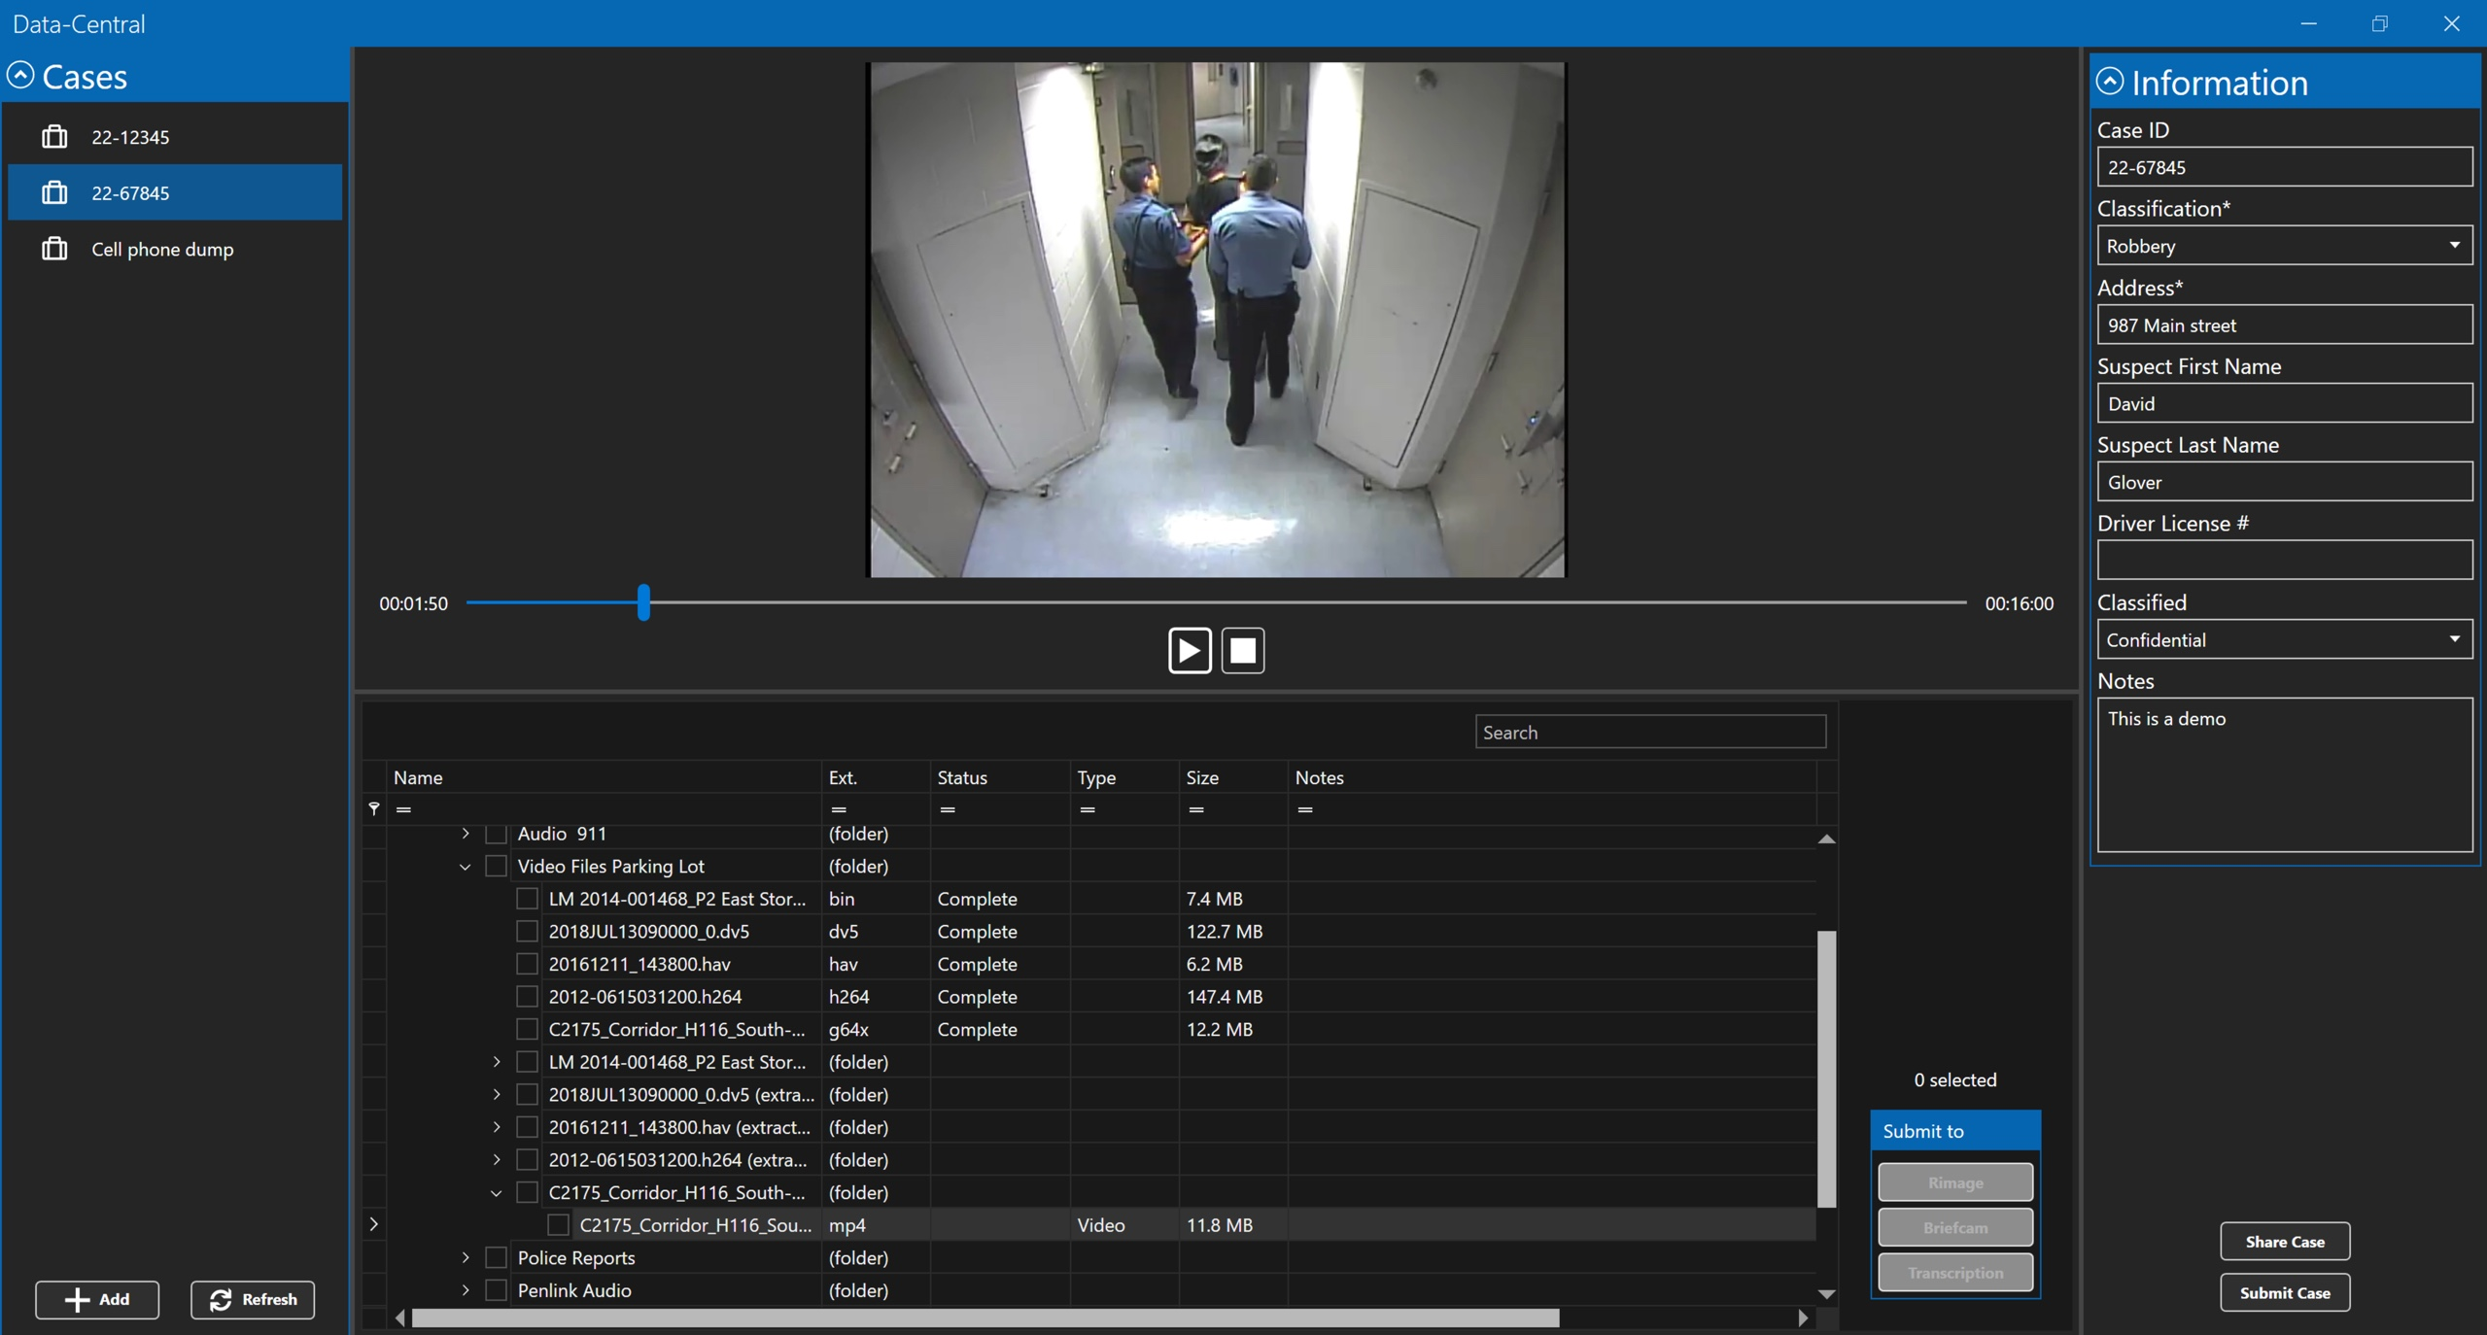
Data-Central / Case Creator
WINDOWS STYLE FILE/FOLDER TREE
  Supports original file/folder structure and simple Drag & Drop editing
METADATA FORMS
  Customizable metadata forms with with options for required fields and dropdown lists
ADDITIVE CASE DESIGN
  Add files from Evidence, Photo and Video Management Systems i.e. Body Worn Cameras, In-Car, CCTV, Handheld cameras, Audio Recordings and more

Slide 22
Data-Central / Case Creator
MULTIPLE CASES
  Support for multiple case creations
WORKFLOW CREATION
  Select where you want the case files to go: DEMS, CMS, RMS or to a DVD or thumb drive

Slide 23










Current Workflow Challenges
Investigator
Assigned
Evidence
Retrieved
Video
Transcoding
Detective
Review
Optional
Delete
Copies
Share
Forensic
Enhancement
Upload to
DEMS
Manual
Automatic

Slide 24






Data-Central / Case Creator Workflow
Original Video
& .mp4
Forensic
Enhancement
Detective
Retrieved Evidence
Data-Central
Processing
Upload to
DEMS
Detective
Review
Optional
Share
Manual
Automatic

Slide 25
Data-Central / Case Creator
VIDEO / PHOTO REVIEW
  View the working copy of the proprietary video in seconds
PROPRIETARY VIDEO CONVERSION
  Rewrap proprietary video in seconds and extract multiplexed videos from executable applications without opening the app

Slide 26

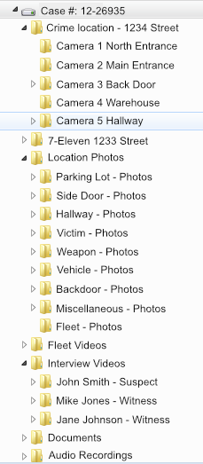

Data-Central Workflow
JSON, XML, CSV and others
Case # 12-26935
Camera Name: 1 North Entrance
Start Time/Date: 05:24 03/04/12
End Time/Date: 05:49 03/04/12
Suspect name: John Smith
Location: 1234 Street Address
Event Type: Armed Robbery
Lead Detective: Mike Jones:
HMS
CAD
DEMS
CMS
RMS
JMS
SHA-256 - Hash
AES 256 Encryption
JJMS
IMS
DIMS
FMS
3rd PARTY BACKEND INTEGRATIONS
Records Management System
Patient Management System
Digital Incident Management System
Case Management System
Digital Evidence Management System
Learning Management System
Records Management System
Computer-aided Dispatch
Data-Central on-premise
appliance

Slide 27

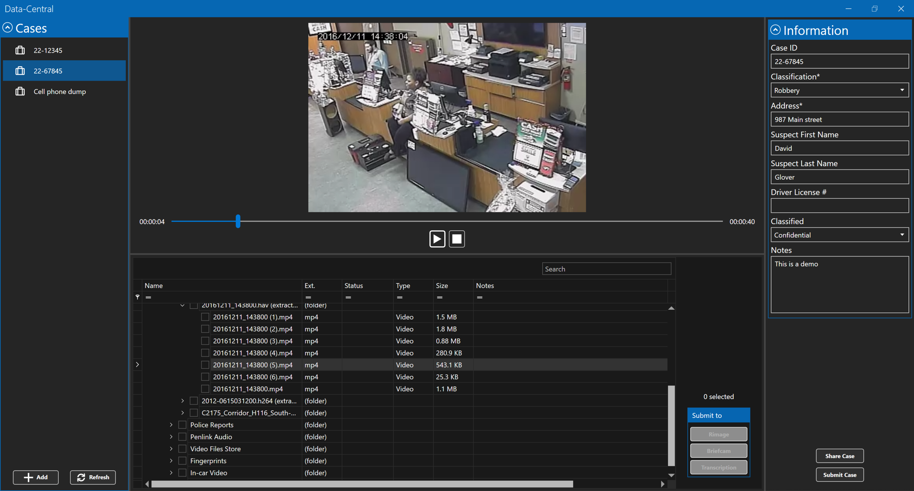







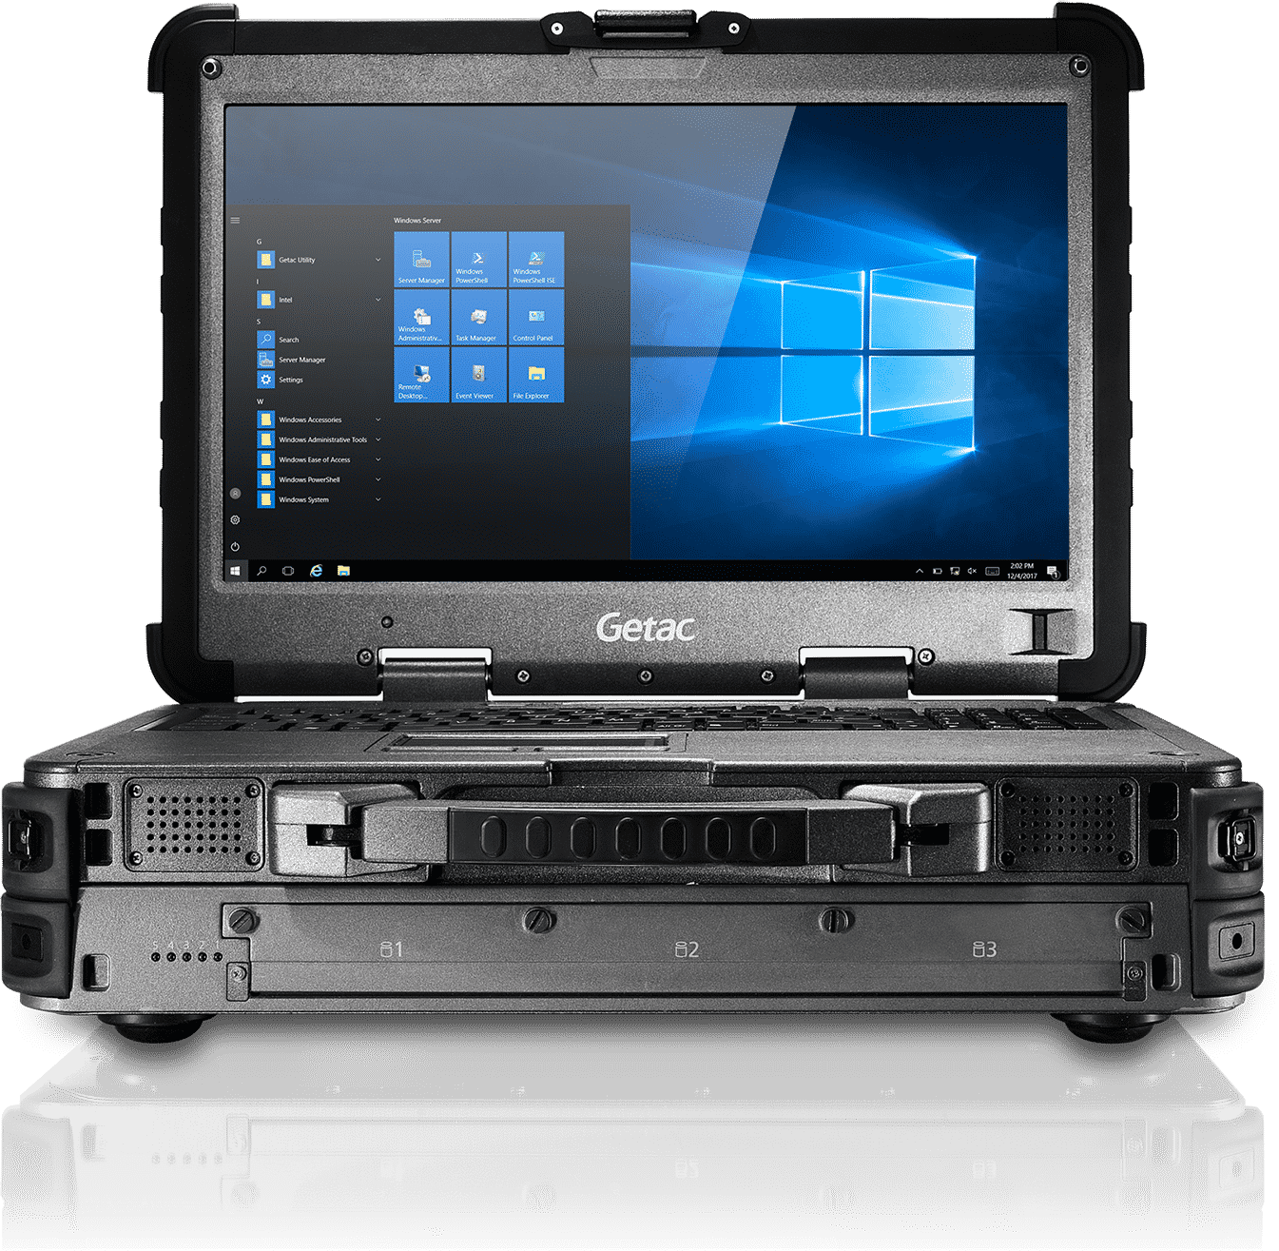

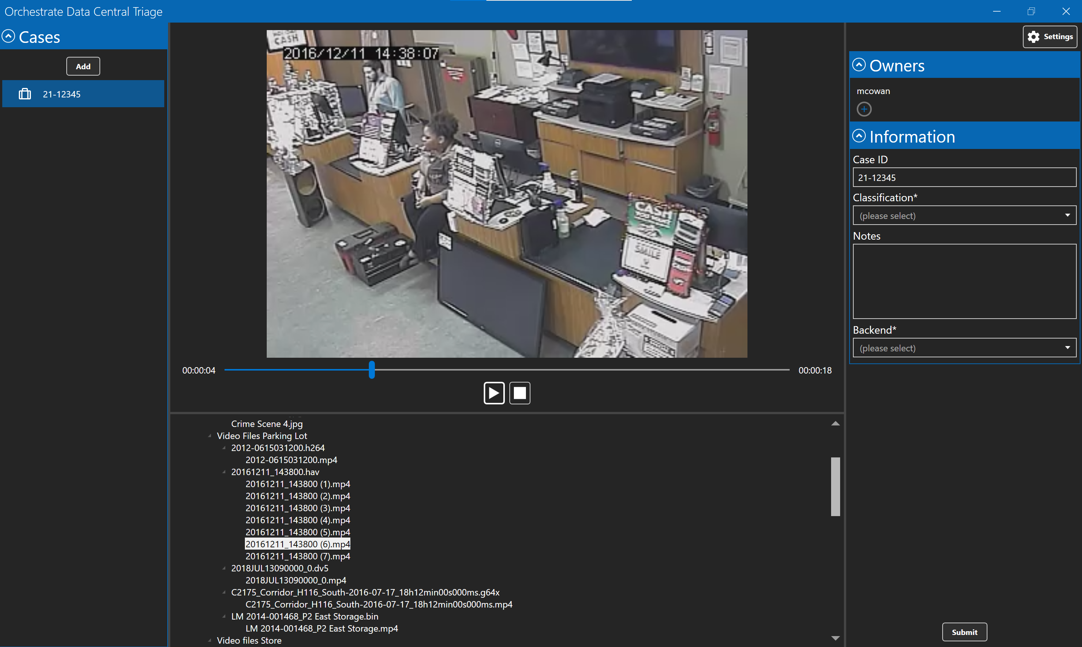



Data-Central Workflow
Schools
Banks
Gas Stations
Retail
Data-Central Mobile enables officers to grab
proprietary video files from businesses running
disparate VMS solutions and watch it within
seconds. Officers can take a screen
shot and send out a person of interest image
immediately.
Train Platforms
Buses

Slide 28
Contact Information
Sales and Partnership Inquiries:
Dave “Glove” Glover; CEO
dglover@dynamicworkflowsolutions.com
Technical Inquiries:
Miles Cowan; CTO
mcowan@dynamicworkflowsolutions.com

